Slide 1
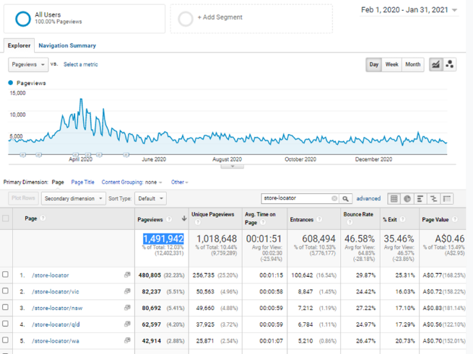


Amcal Store Locator Page Refresh
HARISH MAHENDRAKAR
Website Experience Manager
Why we need to get Store locator pages updated…
Analytics:
Second most visited page on the website.
1.5 million pageviews (last Sigma financial year)
Avg. spend time on the page is 2 min. (this means visitors are looking for more information)
SEO:
The more information we have on the page about the store, the better it is for Google to rank us higher in Google search results
The higher we are on Google search result page, more keywords we will be ranked for e.g. Keyword “pharmacy in Rowville” and so on
User Experience:
Every store will have a page that has all the information and will behave like a mini website for the store
According to Google, more information/team images we have about the store on the website, more likely the customer is to visit the store
It will also helps to increase brand experience

Slide 2
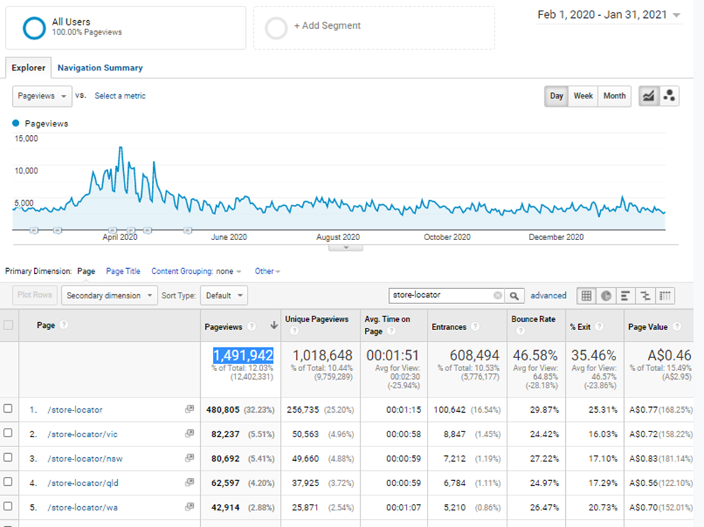

Slide 3
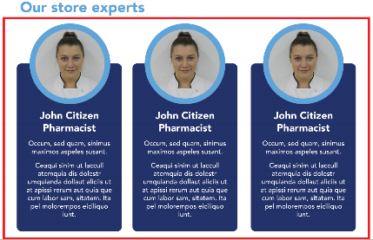
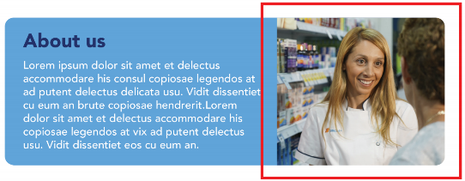
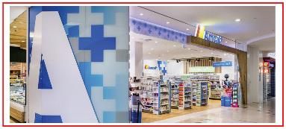
About us content and image
“About us” content with maximum 30 words.
Image: This needs to be an instore image. Can be the pharmacy team.
Please see the example on the demo page.
Our store experts
Minimum of three store staff profile and a maximum of six.
Staff member info: Image, name, position and 30 words (max) bio.
Staff member images:
  All staff members need to have same background (white preferred)
  Profile image cannot be a selfie.
  Demo pic click here
Form Guidelines
Store hours:
Please fill in the store hrs only if they are not correct on the website.
Store front image
Image need to be in landscape mode
Should be taken in daytime when the store is open
Need to be in high resolution
Should not be on an angle
Please see the example on the demo page.
Select services:
Please select all the services that your store offer.

Slide 4
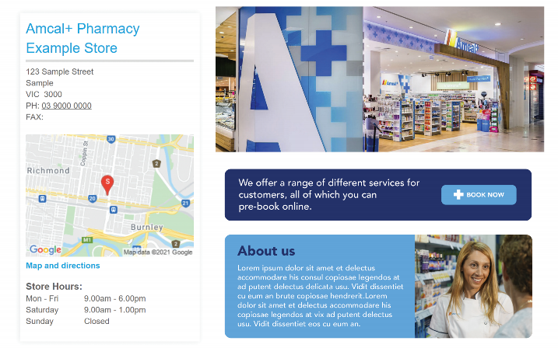
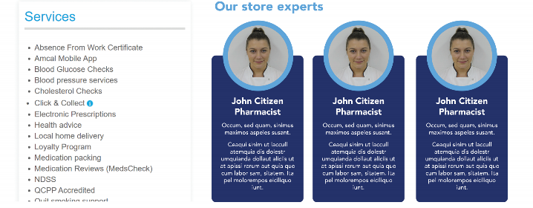
Refresh store page
All Franchise partner are requested to fill in the form by 18th Aug 2021 to get your store page refreshed.

